Slide 1
Everglades: AI and Reinforcement Learning
Alan Perrow
Bao Hong
Benjamin Le Heup
Jace Mixon
Michael Laager

Slide 2
Project Goals
We at least want to meet these “Nice to Have” goals:
Agent should consistently achieve:
>75% win-rate against an agent with a random action selection strategy
>60% win rate against state machine agents with discernible strategy
Implement four different reinforcement learning techniques
But we are also striving to meet these “Home Run” goals:
Agent should consistently achieve:
>95% win rate against an agent with a random action selection strategy
>75% win rate against state machine agents with discernible strategy
Agent should be able to beat all agents from other universities.
Notes:
Introduce myself as part of the AI (reinforcement learning) Team Gold.
Discuss project goals.
Four algorithms: DQN, PPO, then two others from {DDPG, Ranbow DQN, A3C / A2C, HER / PER)
Perhaps a combination of these algorithms could be used to improve training results.
Summarize by stating how another goal is to, of course, become proficient in AI and Machine / Reinforcement Learning

Slide 3
State of the Art
AlphaGo Zero
Achieved better performance, winning 100-0 against its predecessor AlphaGo Lee, which was the AI that defeated the 18-time world go champion Lee Sedol
Instead of using some supervising learning from previous version, this is a self-play trained reinforcement learning.
Use neural network and MCST to train
Dota 2 Open Ai Five
An AI that performed well in a High Dimensional action and observation space.
Defeat a world champion team in 2018 in a five-to-five match
Use a recurrent neural network for training and PPO to optimize the policy

Slide 4
Agent Training Methods
 | On-Policy | Off-Policy | Discrete spaces | Continuous Spaces | Q-Value Function | Policy function
DQN |  | ✔ | ✔ |  | ✔
PPO | ✔ |  | ✔ | ✔ |  | ✔
A3C | ✔ |  | ✔ | ✔ | ✔ | ✔

Slide 5
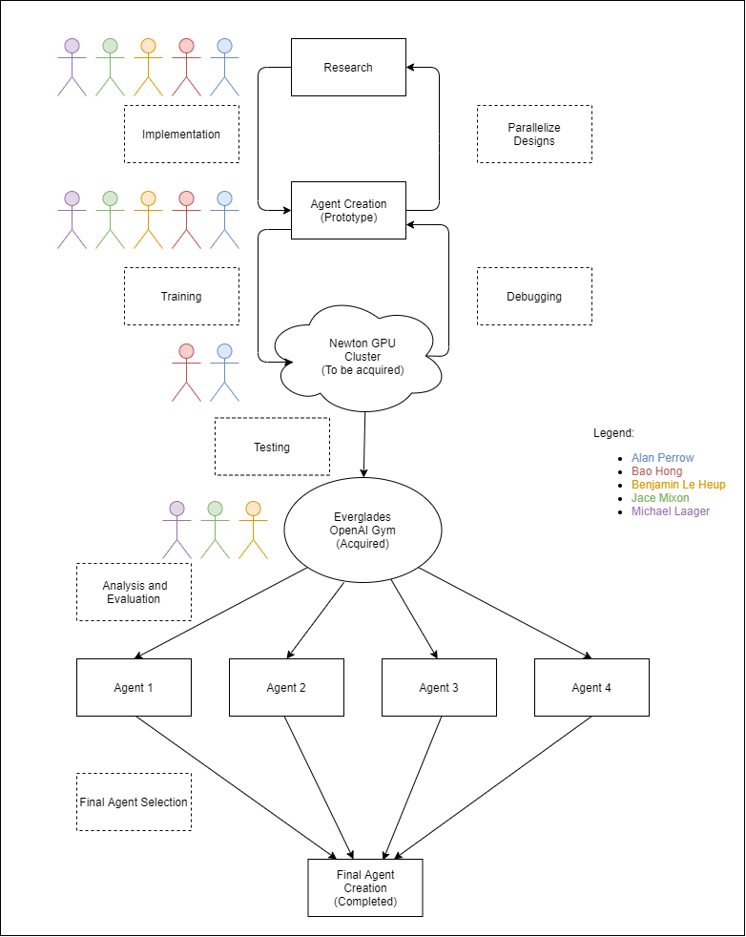
Project Diagram

Slide 6
Topics of Research
Neural networks with Pytorch
DQN, PPO, A3C and other helpful algorithms
Creating helpful models
Testing methods for finding optimized hyperparameters
Parallel computing

Slide 7
Milestones
Initial DQN Implementation | 10/30/2020
DQN Implementation | 11/20/2020
Initial PPO Implementation | 12/02/2020
PPO Implementation | 12/17/2020
Initial A3C Implementation | 01/08/2021
A3C Implementation | 01/22/2021
Agent 4 | 02/12/2021
Agent Analysis | 02/19/2021
Final Agent Design Implementation | 03/09/2021

Slide 8
Thank you for watching!

Slide 9
Budget Slide
Fig Newton

